Slide 1
Async and Await with Sphero

Slide 2
Difference between synchronous and asynchronous function
synchronous code is executed in sequence – each statement waits for the previous statement to finish before executing.
Asynchronous code doesn’t have to wait – your program can continue to run. You do this to keep your site or app responsive, reducing waiting time for the user.

Slide 3
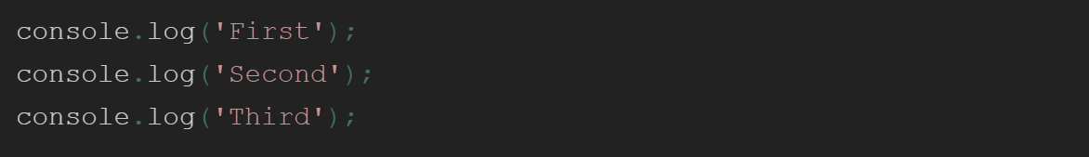
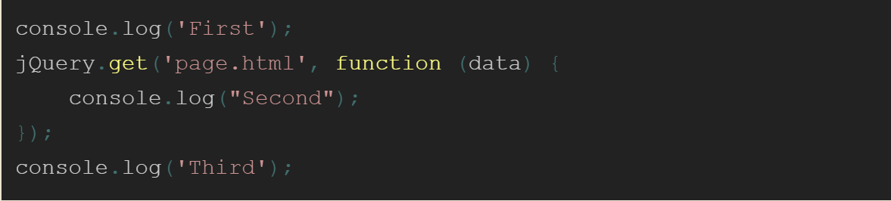
Fig: Synchronous function
Fig: Asynchronous function

Slide 4
Await with Async
We use await to wait until the function returns (or times out).
Every "await" MUST be wrapped in an async function.

Slide 5

Sphero
Sphero robots are fun, durable and programmable toys, first invented by Lan Bernstein and Adam Wilson in 2011!
Sphero balls are programmed with javascript.
You need:
•Sphero robot
•Sphero edu app
•Hunger to learn

Slide 6
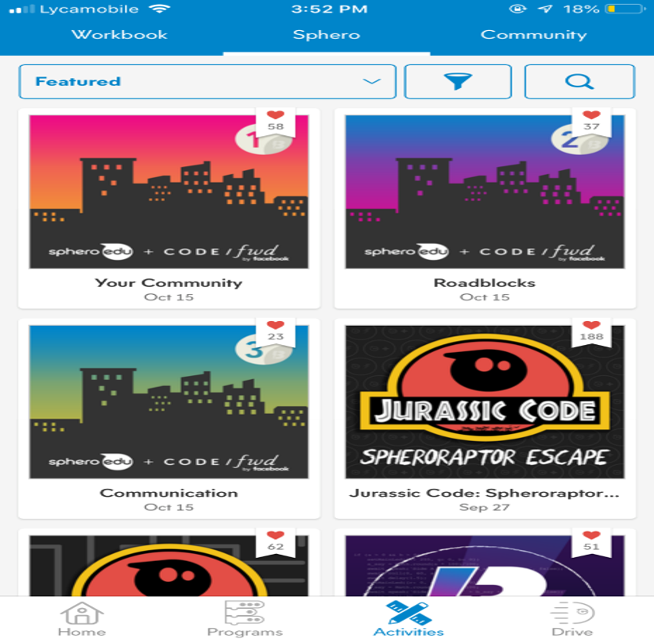
New to Sphero?

Slide 7
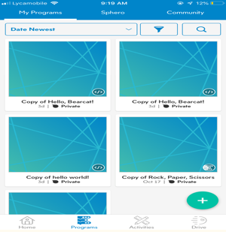
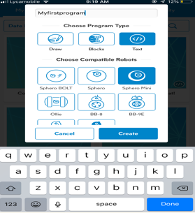
Programming in Sphero edu

Slide 8
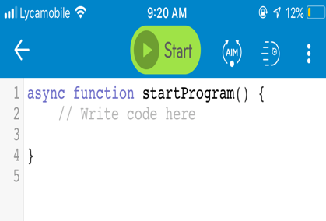
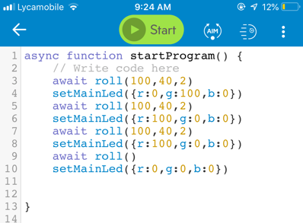

Slide 9
Demo

Slide 10
Thank You

